Slide 1
Thursday
Happy Thursday! ☺

Slide 2
Todays Objectives:
Basic patient care
Documentation
Vital signs monitoring

Slide 3
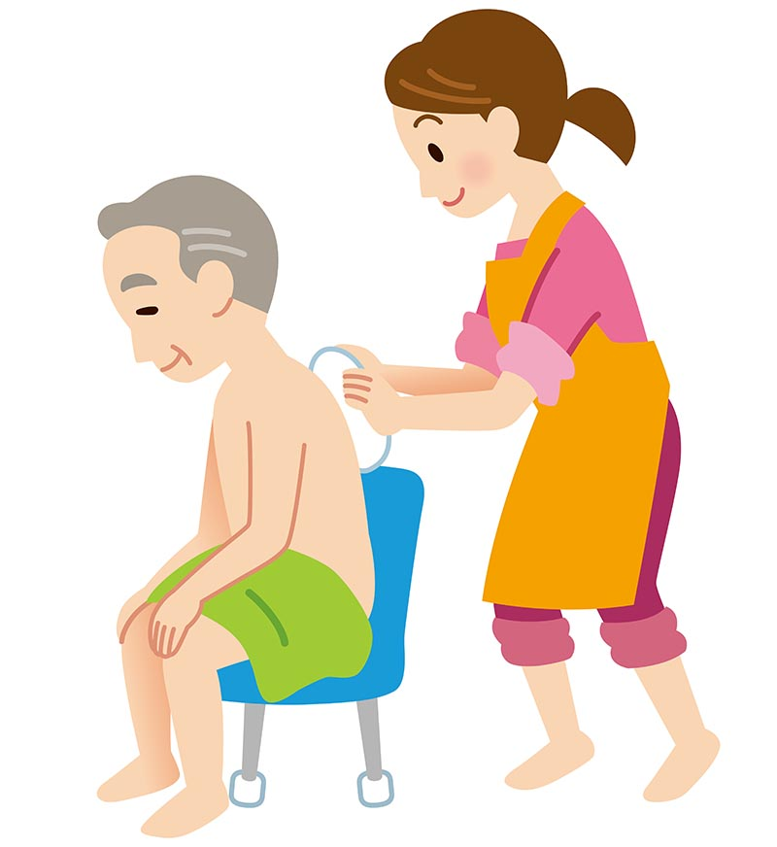
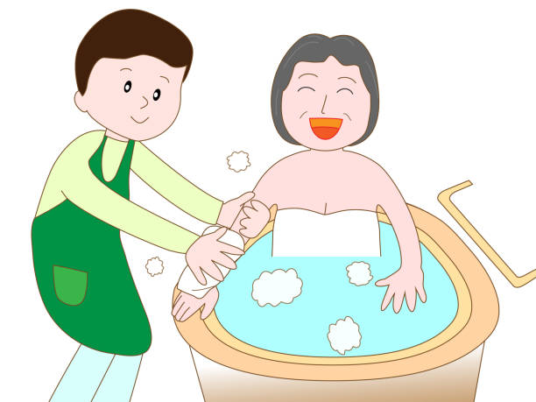
Basic Patient Care

Slide 4
What is basic patient care?
This is the basic needs of someone on a daily basis. We are going to be looking at personal hygiene needs
Personal hygiene is the physical act of cleaning the body to ensure that the skin, hair and nails are maintained in an optimum condition (DoH 2001). Many patients at Holy Cross are unable to make choices or provide consent. Nursing staff will gain consent and involve the patient if possible. The patient’s care plan and manual handling documentation should be checked prior to the procedure. Hands may be cleaned by washing or alcohol gel during procedure.

Slide 5
Activity! Lets discuss Think; what aspects of personal hygiene do you think we need to provide to our patients?

Slide 6
Activity! Lets discuss: Think; how would you like to be washed, dressed and all aspects of personal hygiene given, if you were this patient? What is important to you?

Slide 7
Activity! Lets discuss Think; what would be important to you if you were the patient?

Slide 8
Communication
Why is communication important?
Whom do we need to communicate with?
How might we communicate with them?
How can we ensure our communication with them is effective?

Slide 9
Communication
How to provide good Communication with the patient
Be attentive
Ask open questions
Be curious
Summarise
Use the right tone
Be aware of your patient’s situation
Be aware of bias
Communicate in different ways
Adopt shared decision making
Try active listening

Slide 10
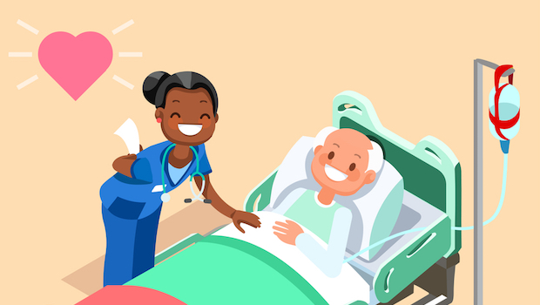
Communication
How to communicate with our patients:
Actively seeking permission
Seeking patient choice
Informing the patient what you are about to do, or are doing – some patents could be partially sighted or blind for example
Clear communication – some patients are hard of hearing and might lip read
Communication aids – glasses, hearing aids, letter/number boards, eye gaze, environmental controls

Slide 11
Communication
Communication with your colleagues
Team working
Coordinating your care
Providing seamless care
Supporting each other
Listen; Don’t just talk
Be specific in your requests
Seek clarification if required
Don’t make assumptions
Think of the patient first

Slide 12
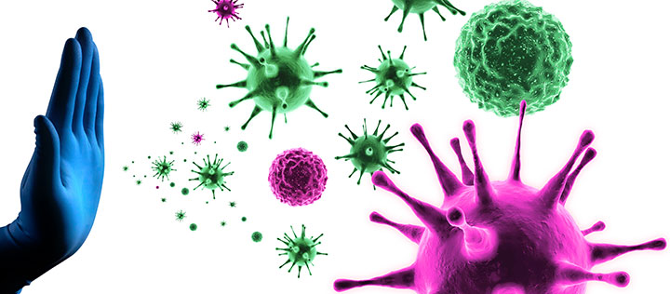
Infection prevention and control
Apply the knowledge you gained from earlier in the week for IPC
Talk to me about the following in relation to providing basic patient care:
Glove use
Apron use
Hand washing

Slide 13
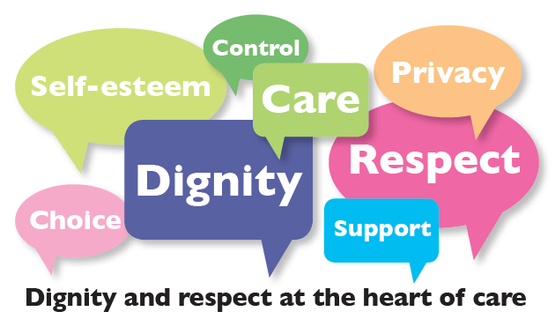
Privacy, dignity, confidentiality, professional behaviours
What is privacy? –
a state of being where you are not observed or disturbed by other people; free from public attention
What is dignity? –
the state or quality of being worthy of honour or respect. providing care that supports the self-respect of the person, recognising their capacities and ambitions, and does nothing to undermine it
What is confidentiality? –
the state of keeping or being kept private
What are professional behaviours?-
a form of etiquette in the workplace which is linked primarily to respectful and courteous conduct.

Slide 14
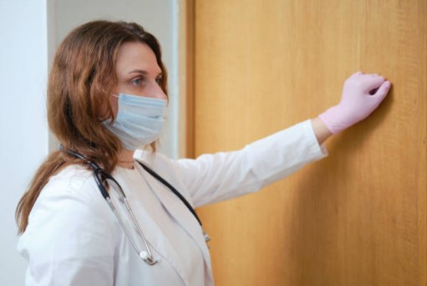
How can we preserve patient privacy?
If you were the patient; How would you like your privacy maintained?
Doors closed
Curtains closed
Do not enter sign on the door
Always knock and wait for a reply before entering a closed door

Slide 15
How can we preserve patient dignity?
If you were the patient; How would you like your dignity preserved?
To maintain dignity, staff should always ask for consent before assisting them and communicate openly to talk them through the steps they are taking. It is easy for patients to feel uncomfortable and awkward when it comes to needing help. So by explaining what is happening when it happens, you can reduce this tension and make them feel reassured.
Use towels to cover up the patient when undressing
Seek permission where applicable before touching the patient

Slide 16
How can we preserve patient confidentiality?
If you were the patient; How would you like your confidentiality maintained?
Keep confidential all information about patients in compliance with the law, including information which is handwritten, digital, visual, audio or retained in your memory. Maintain confidentiality when communicating publicly
Not talking about other patients in the current room

Slide 17
How can we maintain our professional behaviours?
If you were the patient; how would you expect the staff attending to your needs to behave?
Do not talk about your personal life
It is recognised that you will get to know your patients very well at Holy Cross; however it is important to remember not to become unprofessional in how you conduct yourself and in how to talk and what you talk about. E.g no inappropriate language.

Slide 18
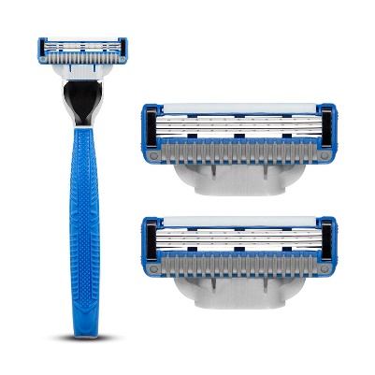
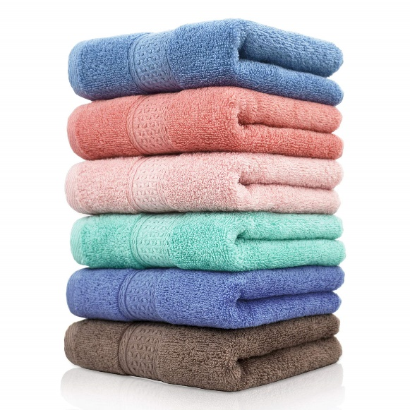
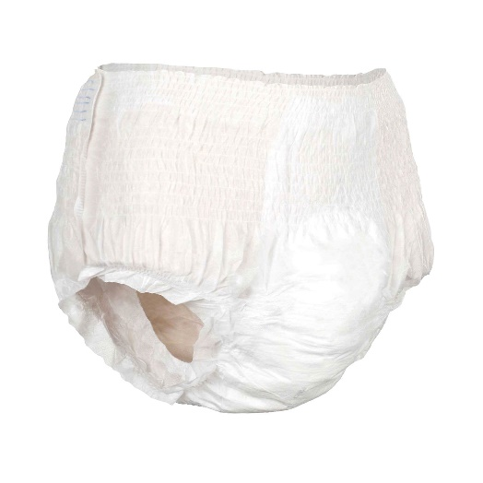
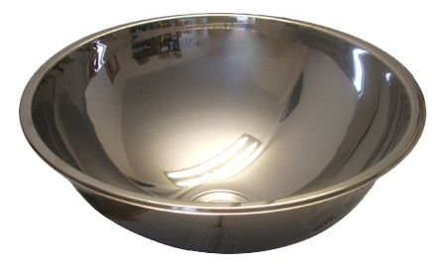
Preparation – what might you need at the bedside?
Towels
Appropriate clothing
Attends
Soaps
Creams
Flannel
Wipes
Buckets
Prescription creams
Water bowl with fresh warm water in
Shaving foam
razor

Slide 19
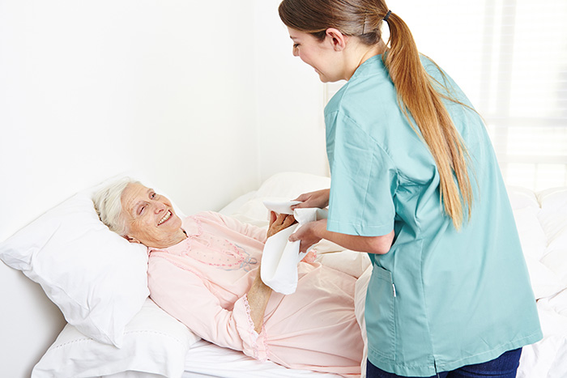
The procedure for washing and dressing- as per the HXH clinical manual guidelines

Slide 20
The procedure for washing and dressing
Action | Rationale
Explain procedure to patient | Gain consent and cooperation
Prepare environment and equipment | Maintain safety and promote privacy and dignity
Stop enteral feed and flush tube | Reduce risk of vomiting or aspiration
Wash hands; put on plastic apron | Reduce risk of cross infection
Put on disposable gloves empty urine bag and detach from leg bag | Prevent back flow of urine or catheter being pulled causing trauma
Remove gloves, wash hands | Reduce risk of cross infection
Remove patient’s clothing or provide necessary assistance Make patient comfortable, strip bed and cover patient with a sheet | Maintain privacy and dignity Keep patient warm and comfortable

Slide 21
The procedure for washing and dressing
Position slide sheet under patient
Using flannel wash rinse and dry face, neck and ears Use patient’s preferred method of facial cleansing if known
Shave male patient or provide necessary assistance
Using flannel wash, rinse and dry top half of body starting with the side furthest away Protect any tubes in situ | Prevent trauma

Slide 22
The procedure for washing and dressing
Change water, put on disposable gloves Inform patient genital area is to be washed Wash and dry area using disposable wipes and large towel Remove gloves, wash hands | Reduce risk of infection
Change water | Reduce risk of infection
Using flannel wash rinse and dry legs starting with side furthest away

Slide 23
The procedure for washing and dressing
Using flannel wash back Wearing gloves wash sacral area using disposable wipes Remove gloves, wash hands
Apply any prescribed creams Replace convene/ pads as appropriate
Dress patient with appropriate choice of clothes If patient is to remain in bed change bottom sheet during turning Reposition pillows, rolls etc as per care plan | Maintain optimum posture and positioning

Slide 24
The procedure for washing and dressing
Transfer patient to chair using sling and hoist – 2 nurses to be present | Safety
Carry out oral hygiene and grooming | Maintain hygiene and promote positive body image
Re start enteral feed, place in bag and attach to back of wheelchair Place nurse call or other equipment used by patient within easy reach | Maintain nutrition and hydration
Put equipment away and tidy room | Maintain a safe environment
Remake bed, place T roll plus pillows on bed | Keep room tidy
Remove apron, wash hands | Reduce risk of cross-infection
Complete appropriate documentation

Slide 25
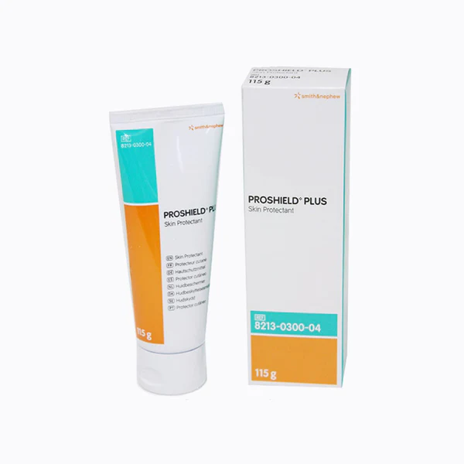
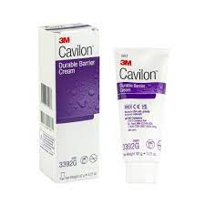
Creams; lotions and potions
Why might our patients need creams?
What sort of creams might we use?
The skin
the skin is an organ and needs to be nourished.
The skin gets exposed to all external elements
Can you think what might harm the skin?

Slide 26
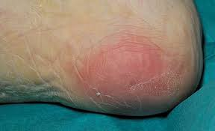
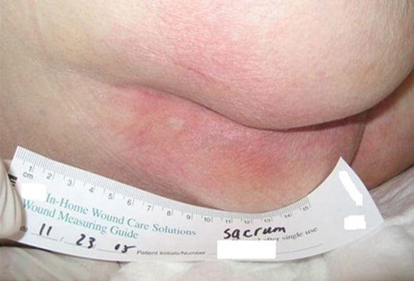
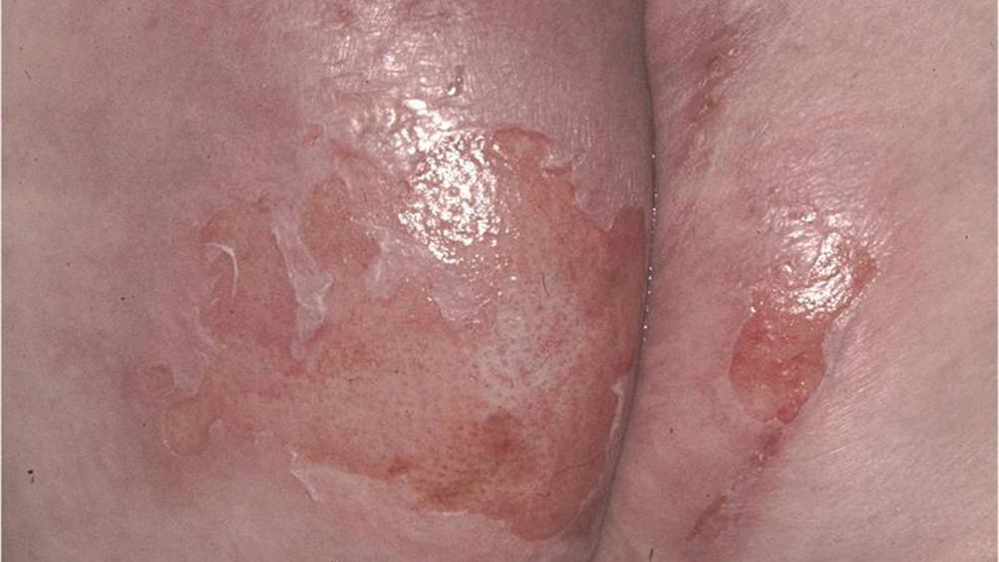
Skin inspection
Why do we need to inspect the patients skin?
Why is during personal care the best time to do it?
What are we looking for when inspecting skin?
Signs of pressure damage
Signs of moisture damage
Bruises
Abrasions

Slide 27
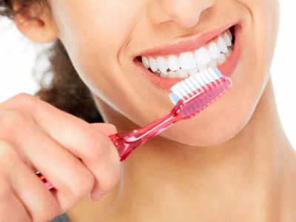
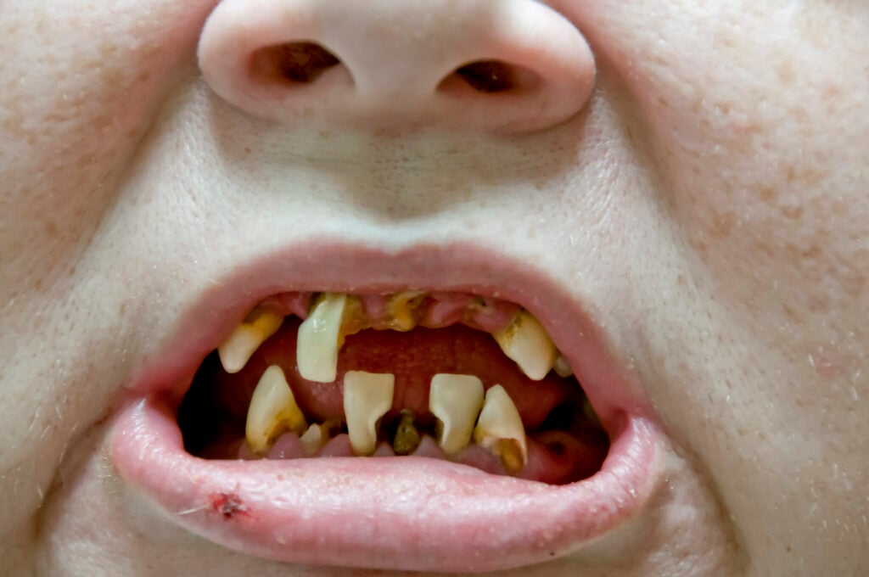
Oral hygiene
What is oral hygiene?
Why is it important?

Slide 28
Oral hygiene
Mouth care is a crucial aspect of nursing care at Holy Cross Hospital. The aim of providing effective mouth care for patient at Holy Cross is to maintain self-esteem, comfort and the person’s ability to communicate. A clean and infection free mouth is really important for the patient at Holy Cross is to enjoy his/her food and drink, and communicate with staff, family and friends. For these reasons, mouth care should be regarded as a vital aspect of daily nursing care. When this is carried out effectively for patients with neuro-disability, it will serve to prevent more clinical complications and unnecessary treatment.

Slide 29
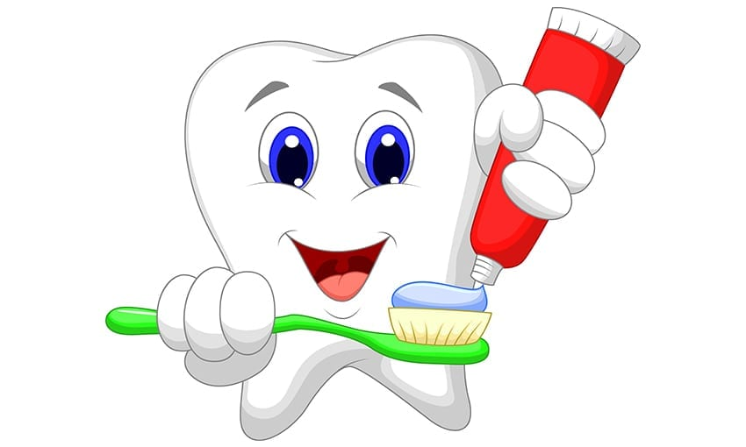
Oral hygiene
Aims of good mouth care
Identify at risk patients
Achieve and maintain oral cleanliness
Prevent infection
Keep oral mucosa moist
Prevent halitosis and freshen/hydrate the mouth
Keep lips clean, soft, moist and intact
Remove debris and plaque without damaging the gums
Alleviate pain and discomfort to enhance oral intake (Mallett and Dougherty 2000)

Slide 30
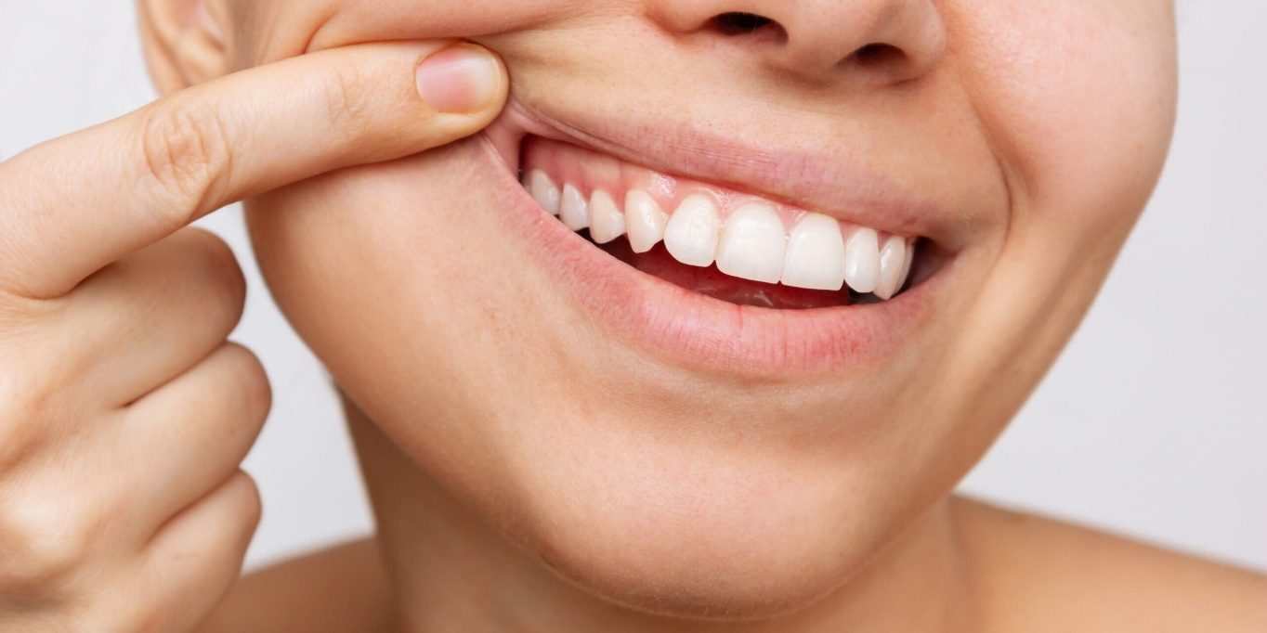
Oral hygiene
Indicators of a healthy mouth
Moist mucosa
Pink mucosa
Clean teeth
Absence of halitosis (bad breath)
Absence of ulcers
Healthy gingival (gums)
Well-fitting dentures

Slide 31
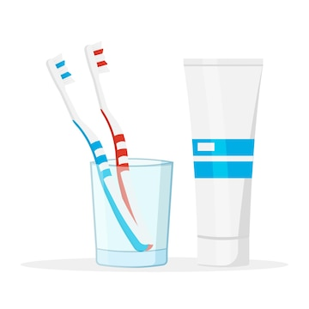
Oral hygiene
Equipment required:
Disposable apron and gloves
Mouthwash
Plastic cup or beaker
Tissues
Wooden spatula
Clean bowl or receiver
Swabs
Toothbrush and toothpaste
Small torch
Denture pot

Slide 32
Oral hygiene
Action | Rationale
Explain and discuss the procedure with the patient. When possible encourage patient to carry out their own oral care | To ensure that the patient understands the procedure and gives valid consent. Also to enable patients to gain confidence in managing their own symptoms
Assemble all equipment needed for the procedure | To ensure all the equipment needed is available
Wash hands and put on apron and gloves | To reduce risk of cross infection
Prepare solution required | Solution must always be prepared immediately before use to maximise their efficiency and minimise the risk of microbial contamination

Slide 33
Oral Hygiene
Carry out oral assessment using oral assessment tool (see table 1) | Provide baseline to enable monitoring of mucosal changes and evaluate response to treatment and care
Inspect the patients mouths including teeth, with the aid of a torch, spatula, and gauze, paying special attention to the lips, buccal mucosa, lateral and ventral surfaces of the tongue, floor of the mouth and the soft palate. If possible ask the patient if they have any of the following; change in saliva production and composition, oral discomfort or difficulty swallowing | The mouth is examined for changes in condition with respect to moisture, cleanliness, infection or bleeding areas, ulcers and so on. These areas are known to be more susceptible to cytotoxic damage To assess nutritional deficit, salivary changes and pain secondary to oral changes

Slide 34
Oral Hygiene
Hold the brush against the teeth with the bristles at 45 degree angle. The tips of the outer bristles should rest against and penetrate under the gum. Then move the bristles back and forth using horizontal or circular strokes movement with gentle pressure for 2 minutes. Repeat until all tooth surfaces have been cleaned. Clean the biting surfaces by moving the toothbrush back and forth over them in short strokes and brush the tongue to remove debris | Brushing loosens and removes debris trapped on and between the teeth and gums, minimises the risk of plaque formation and dental cavities

Slide 35
Oral hygiene
Give a beaker of water and mouthwash to the patient. Encourage the patient to rinse their mouth vigorously then spit the contents into a kidney dish. Paper tissue should be to hand to dry any spillage of the water or dribbling. | Rinsing removes, loosened debris and toothpaste, and makes the mouth taste fresher.
If the patient is unable to rinse and spit, use toothbrush to clean the teeth and moistened gauze wrapped around the toothbrush to wipe the gums and oral mucosa | To remove debris as efficiently as possible

Slide 36
Oral hygiene
Discard remaining mouthwash solution | To prevent infection
Clean the toothbrush and allow to air dry | To prevent risk of contamination
Remove the gloves. Wash hands with soap and warm water and dry hands with paper towel | To reduce risk of cross infection
Ensure the patient is comfortable

Slide 37
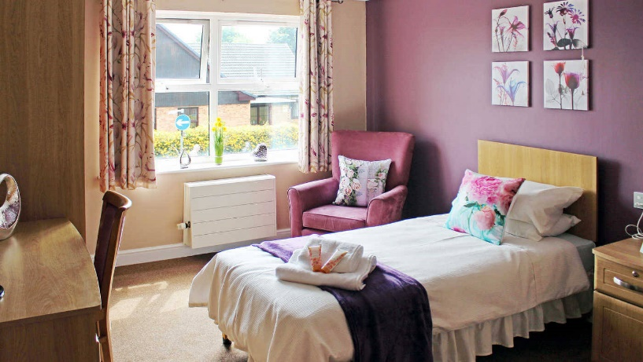
How should the room be left?
How would you like your room to be left?
What would be important to you in how your room is presented?
Rooms should be left clean, tidy and free of clutter.
Beds should be made, sheets should be visibly clean and dry
All wires should be out of the way to avoid any potential trip hazards

Slide 38
Activity: Lets have a go at providing our patient; Bella, with personal care

Slide 39
Any questions?

Slide 40
Time for a tea break

Slide 41
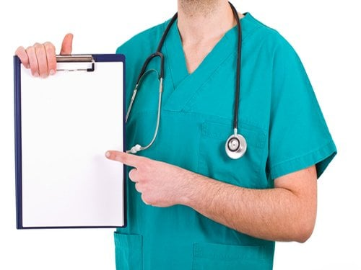
Documentation

Slide 42
What is documentation in health care?
Good documentation is central to good clinical practice.
In providing care healthcare must keep clear, accurate and legible records.
However, lack of awareness, indifference, habits or a combination of these result in deficient entries, leaving both the patient and the clinician at risk.
The quality of clinical documentation assists in optimising the patient’s care

Slide 43
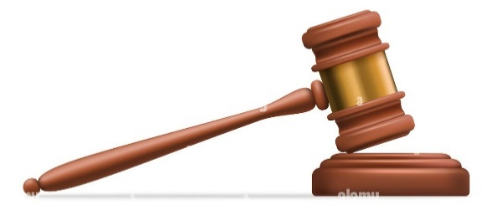
Legalities, responsibilities, contractual duties
Medical notes are a vital means of communication between all those providing care to the patient and also of relevant communication with patients themselves and their relatives
Information from records may provide evidence for any claims made that require legal action and this can occur months or even years after the actual event, demanding a need for accuracy.
Healthcare professionals are accountable for both their actions and their omissions in record keeping.
Poor record keeping can have drastic consequences for the person receiving care
Healthcare professionals are not only accountable to their employer and professional body, but may also be held legally accountable for their actions
Any patient’s medical record can be brought before a court of law as evidence during a trial

Slide 44
Activity! Please write a short paragraph about yourself….. (5-6 lines long)
Now, swap with your colleague; and with the paragraph you’ve now got, please read it. Can you read all of it? Is it easy to read? Ask help from the owner of the handwriting if you need help.
Now swap back and critique your own handwriting – can you read it? Do you think it is easy to read?

Slide 45
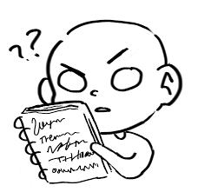
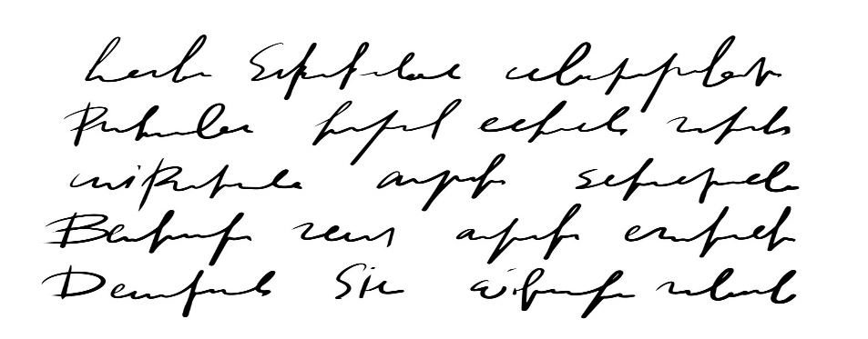
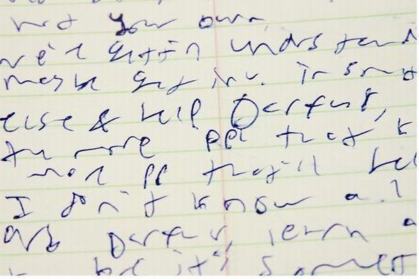
Legible writing
Poor and illegible handwriting is bad practice in both professional and clinical terms
Written notes are the prime means by which vital clinical information is transmitted among staff
ACTION:
Write legibly
Take time to ensure notes are readable
Assess the legibility of your own handwriting and ask the views of colleagues
All entries must be made in black ink.

Slide 46
Importance of signing, printing your name and providing your designation
Every entry must be signed by the person making the entry, name printed, and designation provided.
This is so that is for any reason further information is required or if unable to read the handwriting, the person making the entry can be found to ask.
Jane Smith
01/06/2023

Slide 47
Each page is named
Each piece of paper (and each side of each piece of paper) has to have the patients name and date of birth. This is to ensure if any get lost they can be returned to the collect patient file. And if any are photocopied for hospital transfers etc, then each piece of paper is identifiable.
If you start on or continue on to a new side or piece of paper YOU are responsible for writing the patients name and date of birth on it.

Slide 48
Each entry dated and time stamped
Any entry into the care plan deviation, or MDT notes must be dated and time stamped.
If you need to continue overleaf, you must write the date and “continued” on the new page. Both entries on both sides must be signed.

Slide 49
Countersignatures
You must ensure you registered nurse in charge of your side of patients reads and countersigns your entries in the MDT notes

Slide 50
Combined charts
Combined charts are used to document certain things that happened throughout the day. Such as:
Visually checking
Turns
Skin condition
Inner tube changes
Suctioning
Subglottic aspirations
Cuff volumes
Splints
Vital signs
Dietary and fluid intake
Urinary output

Slide 51
Care plans
Care plans provide risk assessment and management for each aspect of care.
The deviation notes provide a place to document any deviation from the care plan and anything in particular to note.
There are also some charts to fill in on a daily basis.

Slide 52
MDT notes
We document in these at least once in every shift and when any changes are identified or if any significant events happen.
You will document all aspect of care you have provided to your patient
At the end of each entry you must sign, date and print your name.
You must then ask you nurse to read and countersign.

Slide 53
Activity; have a go at filling in:
A combined chart after providing morning care
Care plan after providing morning care
MDT entry at handover

Slide 54
Any questions?

Slide 55
Lunchtime

Slide 56
Vital signs monitoring

Slide 57
What are vital signs?
Vital signs are measurements of the body's most basic functions. The four main vital signs routinely monitored by medical professionals and health care providers include the following:
Body temperature
Pulse rate
Respiration rate
Blood pressure
Vital signs are useful in detecting or monitoring medical problems. Vital signs can be measured in a medical setting, at home, at the site of a medical emergency, or elsewhere.
We check vital signs at least once daily for all patients and as required or directed by your responsible nurse and nurse in charge.

Slide 58
What is temperature
The normal body temperature of a person varies depending on gender, recent activity, food and fluid consumption, time of day, and, in women, the stage of the menstrual cycle. Normal body temperature can range from 36.5 degrees Celsius 37.2 degrees Celsius for a healthy adult
Body temperature may be abnormal due to fever (high temperature) or hypothermia (low temperature). A fever is indicated when body temperature rises about one degree or more over the normal temperature. Hypothermia is defined as a drop in body temperature below normal.

Slide 59
What is the pulse?
The pulse rate is a measurement of the heart rate, or the number of times the heart beats per minute. As the heart pushes blood through the arteries, the arteries expand and contract with the flow of the blood. Taking a pulse not only measures the heart rate, but also can indicate the following:
Heart rhythm
Strength of the pulse
The normal pulse for healthy adults ranges from 60 to 100 beats per minute. The pulse rate may fluctuate and increase with exercise, illness, injury, and emotions.

Slide 60
What are respirations?
The respiration rate is the number of breaths a person takes per minute. The rate is usually measured when a person is at rest and simply involves counting the number of breaths for one minute by counting how many times the chest rises. Respiration rates may increase with fever, illness, and other medical conditions. When checking respiration, it is important to also note whether a person has any difficulty breathing.
Normal respiration rates for an adult person at rest range from 12 to 16 breaths per minute
Activity! Try and count each others respiration rate over a minute

Slide 61
What is blood pressure?
Blood pressure is the force of the blood pushing against the artery walls during contraction and relaxation of the heart. Each time the heart beats, it pumps blood into the arteries, resulting in the highest blood pressure as the heart contracts. When the heart relaxes, the blood pressure falls
Two numbers are recorded when measuring blood pressure. The higher number, or systolic pressure, refers to the pressure inside the artery when the heart contracts and pumps blood through the body. The lower number, or diastolic pressure, refers to the pressure inside the artery when the heart is at rest and is filling with blood.
Blood pressure can be obtained manually and electronically

Slide 62
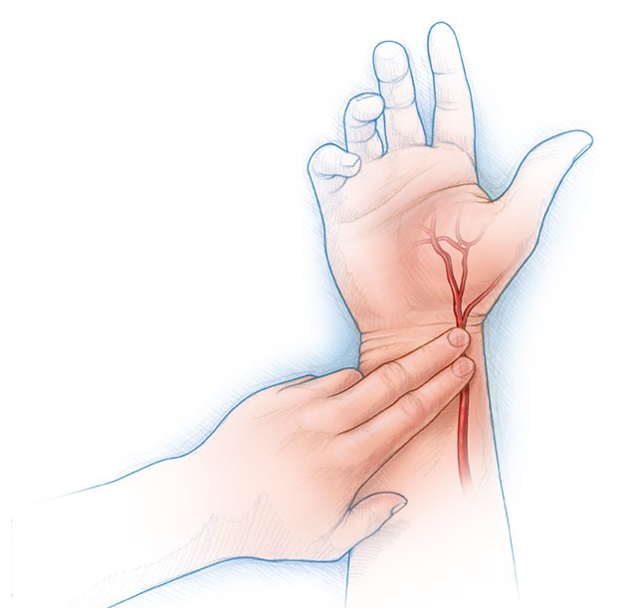
How to take TPR and BP
How to check your pulse
As the heart forces blood through the arteries, you feel the beats by firmly pressing on the arteries, which are located close to the surface of the skin at certain points of the body. The pulse can be found on the side of the neck, on the inside of the elbow, or at the wrist. For most people, it is easiest to take the pulse at the wrist. If you use the lower neck, be sure not to press too hard, and never press on the pulses on both sides of the lower neck at the same time to prevent blocking blood flow to the brain. When taking your pulse:
Using the first and second fingertips, press firmly but gently on the arteries until you feel a pulse.
Begin counting the pulse when the clock's second hand is on the 12.
Count your pulse for 60 seconds (or for 15 seconds and then multiply by four to calculate beats per minute).
When counting, do not watch the clock continuously, but concentrate on the beats of the pulse.
If unsure about your results, ask another person to count for you.
Activity; try taking your own pulse, and then try to take each others

Slide 63
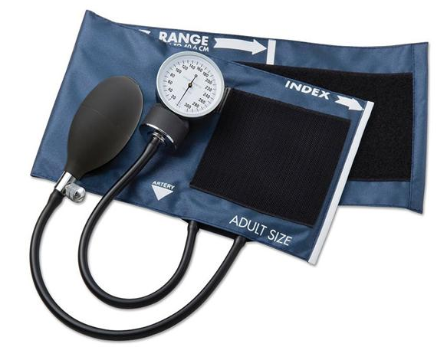
How to take TPR and BP
How to check the blood pressure manually
The sphygmomanometer consists of a cuff that houses an inflatable bladder, a manometer (dial) and a mechanism to pump up the cuff, known as the inflation bulb. Measurement of BP involves:
Depressing the inflation bulb, forcing the air inside into the bladder in the cuff
Releasing the bulb, allowing air to re-enter the bulb
The process is then repeated.
Opening the valve attached to the inflation bulb slowly releases air from the bladder, the cuff pressure falls and, when the systolic pressure becomes greater than the pressure remaining in the cuff, a sound will be heard through the stethoscope
The sounds that can be heard can often be described either as a faint tapping, thudding or ticking sound — it is the first that is used to determine the systolic reading. As air continues to be released from the bladder, pressure in the cuff decreases further, reducing restrictions on the arteries, the blood flow starts to return to normal and the sounds disappear, indicating the diastolic reading

Slide 64
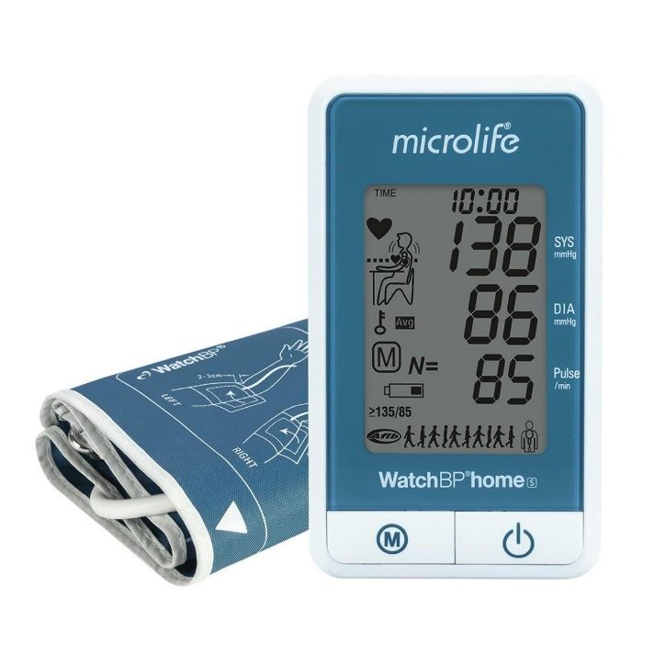
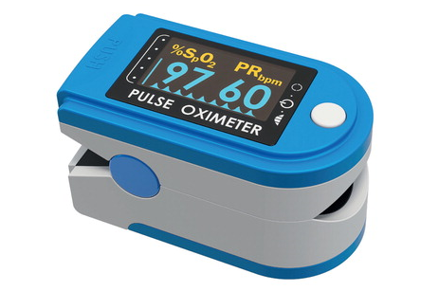
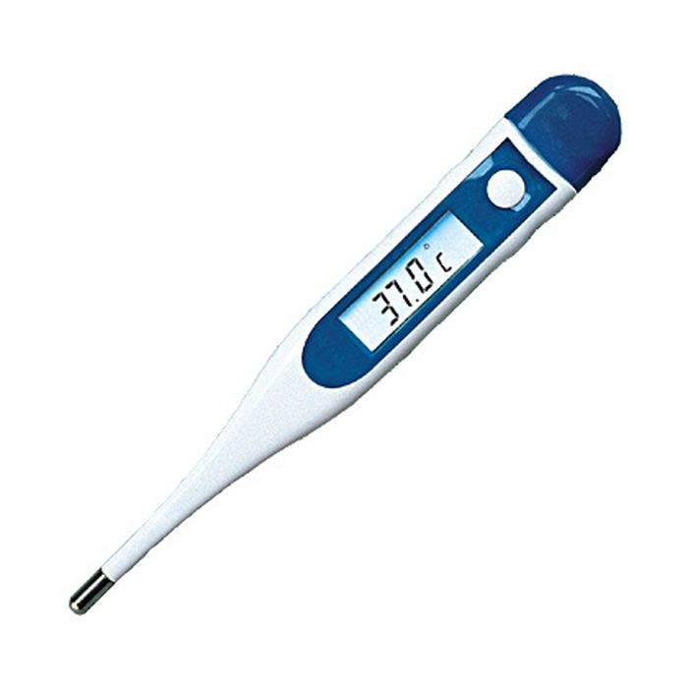
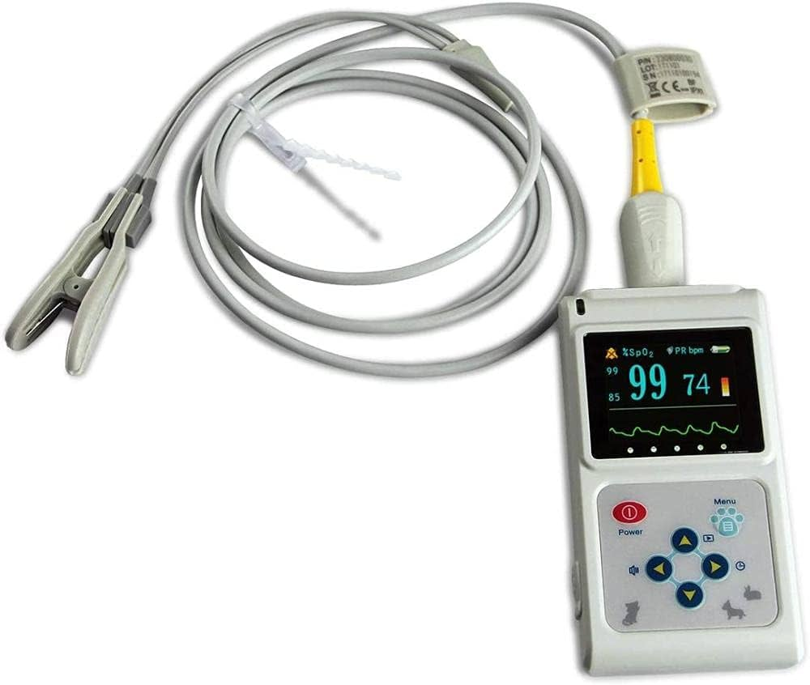
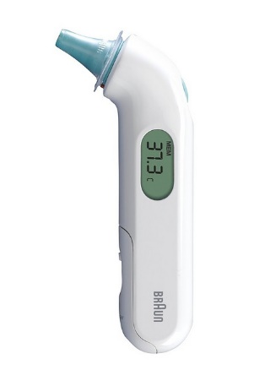
Machines you will likely see in use around the hospital

Slide 65
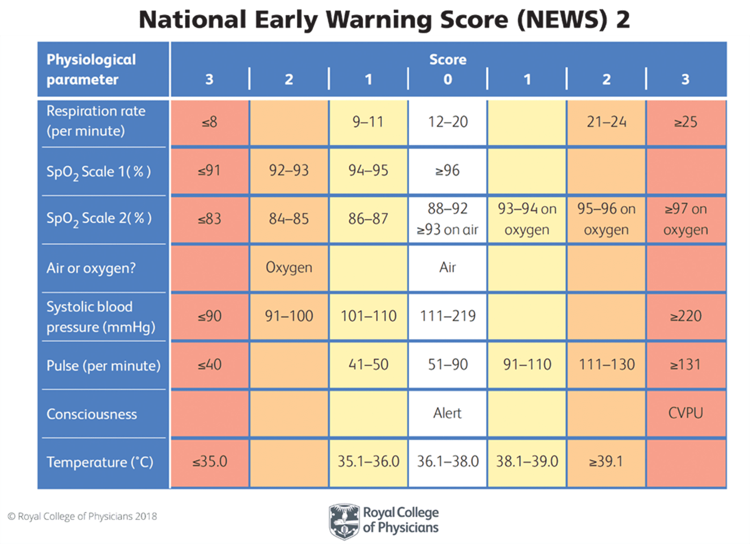
Safe limits

Slide 66
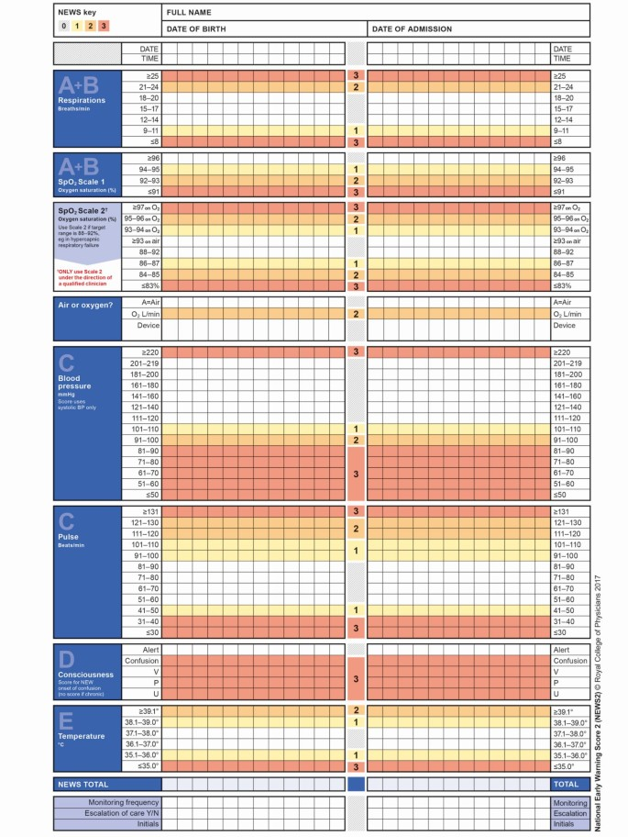
National Early Warning Score 2
The National Early Warning Score (NEWS2) is a system for scoring the physiological measurements that are routinely recorded at the patient's bedside. Its purpose is to identify acutely ill patients, including those with sepsis, in hospitals in England. The NEWS2 scoring system measures 6 physiological parameters:
respiration rate
oxygen saturation
systolic blood pressure
pulse rate
level of consciousness or new-onset confusion
temperature

Slide 67
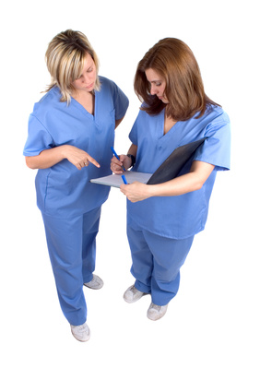
What should you do with the results?
Report!!
To whom would you report it to?
To your responsible nurse or nurse in charge
Document!!
Where would you document it?
Combined chart
Care plan
MDT notes
NEWS2 chart if in use

Slide 68
Activity; Your turn: have a go at taking a set of vital signs manually and electronically on each other and documenting them on the vital signs chart and the NEWS2 chart

Slide 69
Any questions?

Slide 70
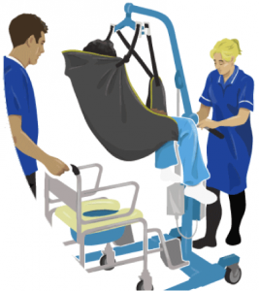
Safe moving and handling refresher

Slide 71
Moving and handling refresher
What can you remember from your session with Donna on Tuesday?

Slide 72
Risk assessment – can you remember what the acronym is that we use?
E-L-I-T-E
E Environment
L Load
I Individual’s capabilities
T Task
E Equipment

Slide 73
Activity; please talk to me about the following in relation to moving and handling
Posture
Positioning
Care plans
Safety
Communication

Slide 74
Activity; in pairs, please show me how to: - safely hoist a patient from bed to chair and back again - slide a patient up the bed and onto their side then onto their other side

Slide 75
Any questions?

Slide 76
Thank you for listening and participating!

